Slide 1
Introduction to Data Science – Week 9
Daniel D. Gutierrez
Data Scientist
COM SCI X450.1
UCLA Extension

Slide 2
Course Outcomes – Week 9
Explore supervised machine learning for prediction
How to use the linear model in R
How to use R for classification problems using logistic regression and Random Forest
Notes:
This is WEEK 9 of the Introduction to Data Science course offered by UCLA Extension. This module covers supervised machine learning materials.

Slide 3
Lesson Objectives – Week 8
Be able to employ supervised machine learning using – linear regression and classification
Using the lm() algorithm in R
Using the glm() algorithm in R
Using the randomForest() algorithm in R
Training the model to obtain coefficients
Making predictions using the trained model and test set
Measuring performance of the model
Notes:
The lesson objectives for WEEK 9 are to be able to employ a supervised statistical learning technique such as linear regression using the lm() (linear model) algorithm in R.
We’ll also show how to train the model and make predictions using the trained model.
Lastly, we’ll explore the use of both single and multiple linear regression.

Slide 4
Overview of supervised machine learning
Linear regression is the work horse of supervised learning
Classification is the most popular supervised learning technique
Create a training set (60%) to train the model, and also a test set (40%) to test accuracy of model
Feature engineering drives process. Can use forward and/or backward stepwise selection
Notes:
Supervised machine learning is the most common type of machine learning. It is typically associated with prediction, where for each observation of the predictor measurements (also known as feature variables), there is an associated response variable value. Supervised learning is where a model that relates the response to the predictors is trained with the aim of accurately predicting the response for future observations. Many classical learning algorithms, such a linear regression and logistic regression, operate in the supervised domain.
The work horse of supervised learning is linear regression. The method has been around for a very long time and is widely used today.
We’ll take a look at both simple and multiple linear regression, that is, regression with one and multiple predictors.

Slide 5
Simple linear regression
Simple linear regression uses a continuous response variable and one continuous predictor
Use EDA to understand the data: distribution of each feature variable, check correlation using scatterplot
Use lm() to fit a linear model
Use trained model coefficients to make predictions
Plot regression line
Residuals plot – distance between actual points and regression line
Notes:
Linear regression is based on the assumption of a linear relationship between the feature variables (predictors) and a response variable (variable to be predicted). For linear regression, it is assumed that the response variable is quantitative, and the predictors are quantitative or qualitative. The algorithm uses a known linear mathematical function (remember high school algebra) to approximate the “unknown” function that generates the observed data. The known function is often called a “hypothesis” function since it is the one you choose to approximate the actual, albeit unknown function. With linear regression, we assume the unknown function is linear. Using the known function, we can use the data set to “fit” or “train” the model. In this case, we need to learn the set of coefficients of the hypothesis function and the most common approach to fitting the model is called least squares.
We can use EDA to better understand the linear relationship using data visualization
In the associated Code module, we’ll use R’s lm() function to fit a linear model and then use the model coefficients to make predictions.
We also will plot a regression line and see how the residuals plot shows the distance between actual points and the regression line

Slide 6
Multiple linear regression
Multiple linear regression uses a continuous response variable and more than one predictor
Use EDA to understand the data and detect a trend
Use lm() to fit a linear model
Use trained model coefficients to make predictions on test set
Notes:
Although often useful, simple linear regression is only able to make predictions based on a single feature variable. For real life problems however, we often have more than one predictor. Let’s now extend the notion of linear regression to multiple feature variables.
We can use the same least squares approach that we used in the simple linear regression case – finding the coefficients to minimize the sum of squared residuals. We’ll use R’s lm() algorithm once again to find the multiple least squares regression coefficient estimates. R easily handles the multiple linear regression case by computing the same linear model data we saw in the previous section.
A critical element of machine learning is defining the training set and test set for use by the algorithm. The separation of your data set into a training portion and a test portion is the way the algorithm learns. You split up your data set containing known response variables into two pieces. The training set is used to train the algorithm by calculating the coefficients. Then you use the trained model on the test set to predict the response variables (that are already known). The final step is to compare the predicted responses against the observed (actual) responses to see how close they are. The difference is the test error metric.

Slide 7
Classification with logistic regression
Classification using logistic regression with a 2 class (binary) categorical response variable and one or more predictor
Use glm() for logistic regression
Use the trained model to make predictions on test set (probabilities of class membership)

Slide 8
Classification with Random Forest
Classification using the Random Forest algorithm with a multi-class categorical response variable and one or more predictor
Use randomForest() for Random Forest
Use the trained model to make predictions on test set
NOTE: Random Forest also can be used for regression problems

Slide 9
ML algorithm performance metrics
Evaluating model performance
Diagnostic plots
Overfitting
Measuring regression performance: R² and RMSE
Measuring classification performance: confusion matrix and AUC-ROC curve

Slide 10
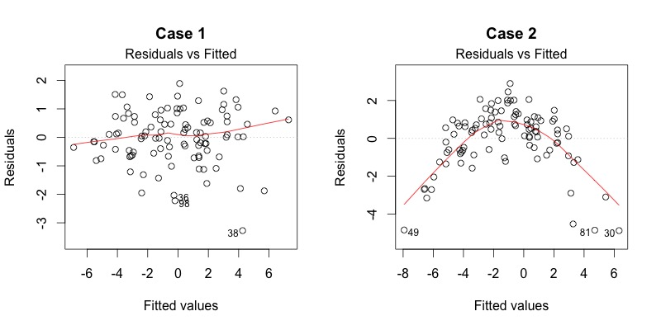
Linear regression diagnostic plots
Notes:
Left side is GOOD, right side is BAD.
The “Residuals vs. Fitted” plot shows if residuals have non-linear patterns. There could be a non-linear relationship between predictor variables and the response variable, and the pattern could show up in the plot if the model doesn’t capture the non-linear relationship. If you find equally spread residuals around a horizontal line without distinct patterns, that is a good indication you don’t have non-linear relationships.
The left side doesn’t show any distinctive pattern, but the right side shows a parabola where the non-linear relationship was not explained by the model and was left out in the residuals.

Slide 11
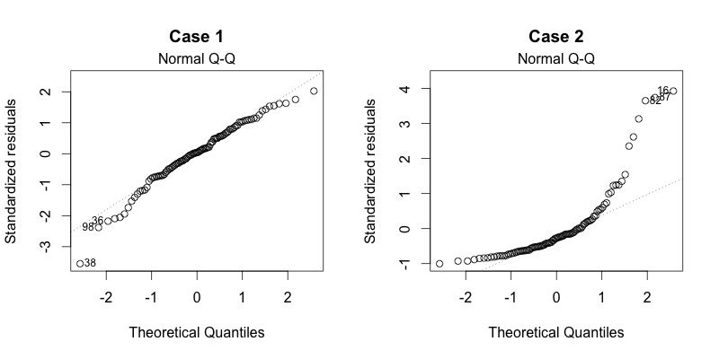
Linear regression diagnostic plots
Notes:
Left side is GOOD, right side is BAD.
The Quantile-Quantile, Normal Q-Q plot shows if residuals are normally distributed. Do residuals follow a straight line well or do they deviate severely? If’s good is residuals are lined well on an upward sloping diagonal line.
The right side is of concern since it deviates from a diagonal line. The left side is not of concern, although observation 38 might represent a problem.

Slide 12
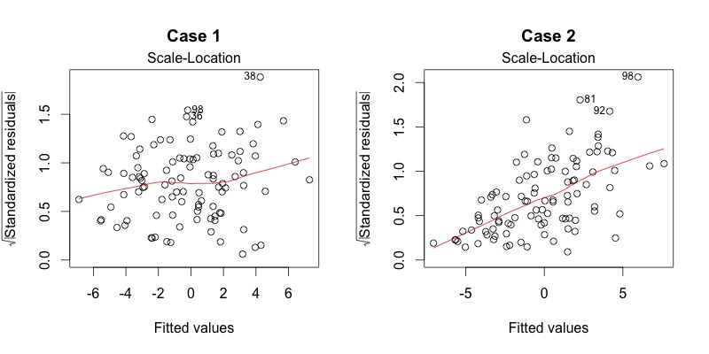
Linear regression diagnostic plots
Notes:
Left side is GOOD, right side is BAD.
The Scale-Location plot shows if residuals are spread equally along the ranges of predictors. This is how you can check the assumption of equal variance (homoscedasticity). It’s good if you see a horizontal line with equally (randomly) spread points.
On the left-side, the residuals appear randomly spread, which is good. On the right=side, the residuals begin to spread wider along the x-axis as it passed around 5. Because the residuals spread wider and wider, the red smooth line is not horizontal and shows a steep angle.

Slide 13
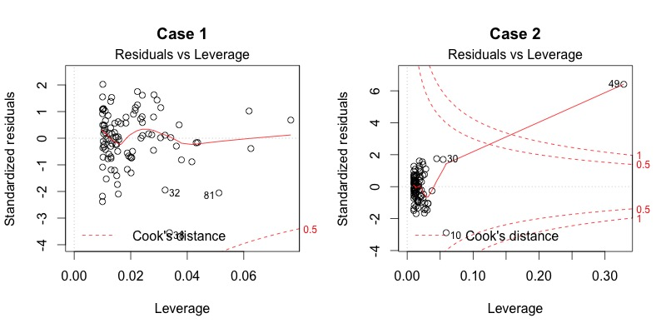
Linear regression diagnostic plots
Notes:
Left side is GOOD, right side is BAD.
The “Residuals vs. Leverage” plot helps find influential observation if any. Not all outliers are influential in linear regression. Even though data have extreme values, they might not be influential to determine a regression line. That means the results wouldn’t be much different if we either include or exclude them from analysis. They follow the trend in the majority of observations and they don’t really matters, i.e. they are not influential. On the other hand, some observations could be very influential even if they look to be within a reasonable range of the values. They could be extreme observations against a regression line and can alter the results if we exclude them from analysis. In other words, they don’t get along with the trend in the majority of the observations.
Unlike the other residuals plots, this time patterns are no relevant. You need to watch out for outlying values at the upper right corner or at the lower right corner. Those spots are the places where cases can be influential against a regression line. Look for observations outside of the dashed line for Cook’s Distance. When observations are outside the Cook’s Distance (meaning they have high Cook’s Distance scores), the observations are influential to the regression results. The regression results will be altered if we exclude those cases.
The left-side example is the typical look when there is no influential observation, or observations. You can barely see the red dashed Cook’s distance lines because all the observations are well inside of the Cook’s Distance lines. The right-side an observation is far beyond the Cook’s Distance lines. The plot identified the influential observation at 49. If you exclude 49 from the analysis, the slop coefficient changes from 2.14 to 2.68 and R-squared .757 to .851 where are both pretty big impacts on the regression analysis.

Slide 14
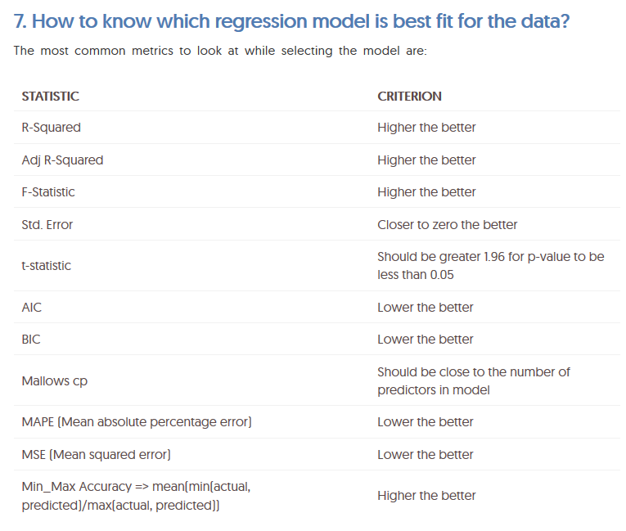
Linear regression diagnostic plots
Notes:
Here is a short cheat-sheet for evaluating the predictive performance for linear models.

Slide 15
Classification AUC-ROC curve
AUC - ROC curve is a performance measurement for classification problems
ROC is a probability curve and AUC represents degree or measure of separability
It tells how much a model is capable of distinguishing between classes
Higher the AUC, better the model is at making predictions
The ROC curve is plotted with True Positive Rate (TPR) against the False Positive Rate (FPR) where TPR is on y-axis and FPR is on the x-axis

Slide 16

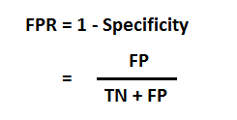

Classification AUC-ROC curve

Slide 17
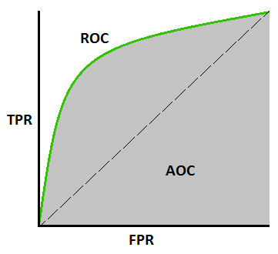
Classification AUC-ROC curve

Slide 18
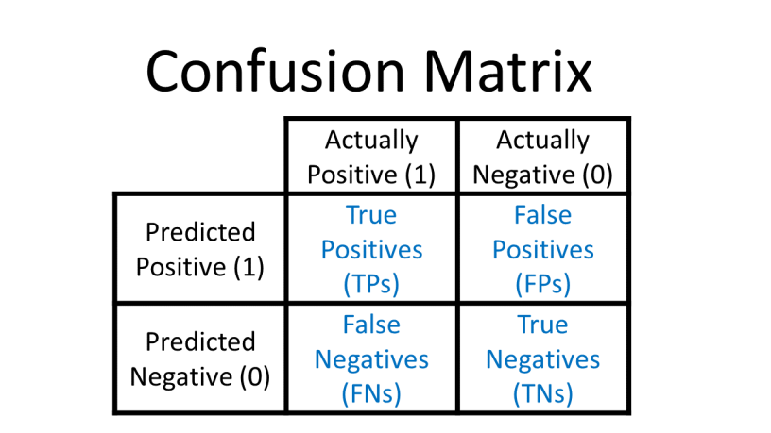
Confusion matrix definition
Notes:
Confusion matrices are calculated using the predictions of a model on a data set. By looking at a confusion matrix, you can gain a better understanding of the strengths and weaknesses of your model, and you can better compare two alternative models to understand which one is better for your application.
The column labels “Actually Positive” and “Actually Negative” refer to the ground-truth labels in your data set, i.e. whether a handwritten digit is truly a 1 or a 0, whether a patient was truly diagnosed with a disease (1) or not (0), whether a chest x-ray actually shows pneumonia (1) or not (0), etc.
The row labels “Predicted Positive” and “Predicted Negative” refer to your model’s predictions, i.e. what your model thinks the label is.
True Positives (TPs): the number of positive examples that the model correctly classified as positive
True Negatives (TNs): the number of negative examples that the model correctly classified as negative
False Positives (FPs): the number of negative examples that the model incorrectly classified as positive (i.e. the negative examples that were falsely classified as “positive”)
False Negatives (FNs): the number of positive examples that the model incorrectly classified as negative (i.e. the positive examples that were falsely classified as “negative”)

Slide 19
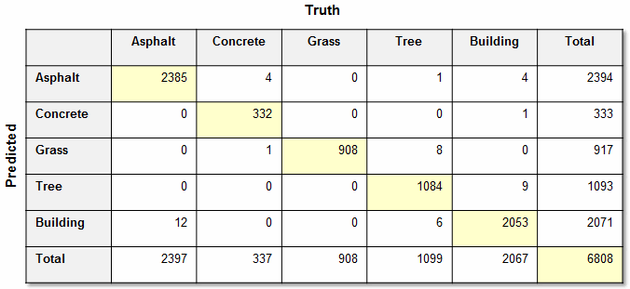
Confusion matrix example

Slide 20
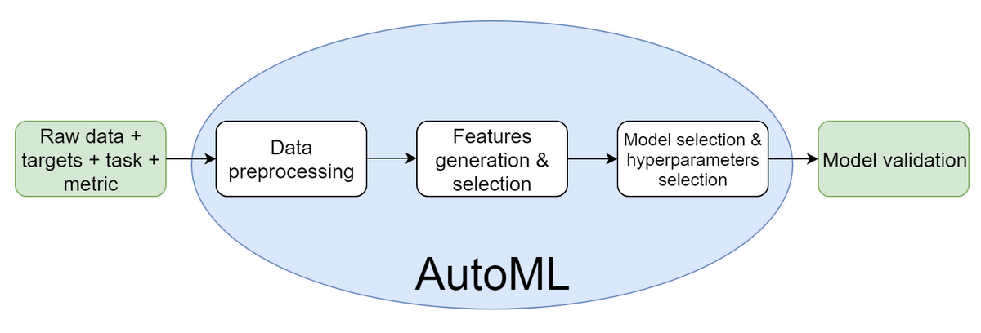
Automated Machine Learning (AutoML)

Slide 21
Code Module 9
WEEK 9-1 Code module – Simple linear regression
WEEK 9-2 Code module – Multiple linear regression
WEEK 9-3 Code module – Logistic regression (binary classification) with single and multiple predictors
WEEK 9-4 Code module – Logistic regression with ROC curves
WEEK 9-4 Code module – Random forest for multi-class classification
Notes:
In order to demonstrate the concepts for WEEK 9, we’ll step through a series of in-depth R code examples found in the Code modules listed.
I encourage you to take the R script file for WEEK 9 and try each code snippet yourself. Take some time to tweak each example and try different things so you’ll fully understand each programming concept.

Slide 22
Summary
In WEEK 9 of Introduction to Data Science, we continued the data science process by exploring a popular supervised machine learning algorithm – linear regression.
We used the lm() algorithm for both simple and multiple linear regression.
We used the glm() algorithm for logistic regression for binary classification with single and multiple predictors.
We used the randomForest() algorithm for multi-class classification.
Notes:
In WEEK 9 of Introduction to Data Science we continued the data science process by exploring a popular supervised machine learning algorithm – linear regression.
We used R’s lm() algorithm for both simple and multiple linear regression. We used data visualization techniques to plot a regression line on top of a scatterplot and we also saw a residuals plot to see how closely the actual points were to the regression line. Lastly, we saw experimented with a very important method in machine learning – splitting the data set into a training set and test set in order to calculate a test set error metric that tells us how well our model generalizes with new data.
We also used R’s glm() algorithm (generalized linear models) for performing logistic regression for binary classification problems.
We also used the randomForest() package and algorithm for performing multi-class classification problems. randomForest() also can be used to regression.

Slide 23
UCLA Extension

